Slide 1
GNSS terminologies & concepts

Slide 2
GNSS + DR
GNSS (Global Navigation Satellite System):
A satellite-based system that provides global positioning, navigation, and timing services by using signals from multiple satellites.
DR (Dead Reckoning):
A navigation method that estimates the current position based on a previously known position, speed, direction, and time, without external signals.

Slide 3
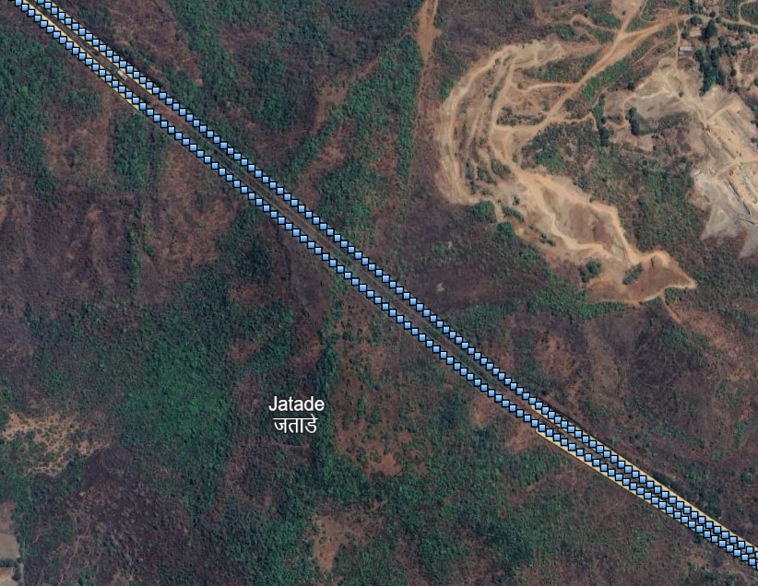

Slide 4
U-BLOX
U-blox modules and chips are multi-GNSS receivers capable of receiving and processing signals from multiple GNSS.
u-blox concurrent GNSS receivers are multi-GNSS receiver have capable receiving signals from more than one GNSS system at the same time, and utilize them in positioning.

Slide 5
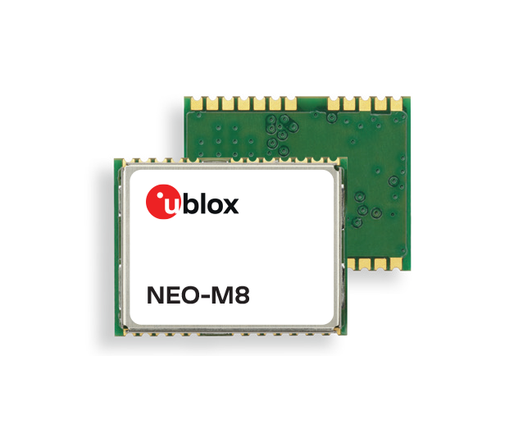
U-BLOX
APPLICATION
satellites
FRAMEWORK
UART
HAL
KERNEL(GPS DRIVER)

Slide 6
open("/dev/ttyHS2", O_RDWR | O_NOCTTY | O_NONBLOCK) is called to establish a file descriptor.
Then read() is used to parse incoming GNSS data (NMEA sentences like $GPGGA, $GPRMC).
write() can send commands to the GNSS chipset.
Often, the HAL sets baud rate (e.g., 115200 or higher) using termios to match GNSS module specs.

Slide 7
Introduction of NMEA frames
NMEA(National Marine Electronics Association)
NMEA messages are sent by the GNSS receiver.
NMEA frames starts with the $ symbol.
NMEA structure
ex : $GPGLL,4717.11364,N,00833.91565,E,092321.00,A,A*60
Start character($) | Address(GPGLL) | Data field | Checksum field | End sequence
Mar 29 18:00:24 imx8dxpsa2020 ublox[1544]: [UBLOX] - GPS_message sending --> $GPRMC,114439.00,A,1254.03598,N,08005.65536,E,0.084,314.31,151222,0.90,W,D*
Mar 29 18:00:24 imx8dxpsa2020 ublox[1544]: [UBLOX] - $GPGGA,114439.00,1254.03598,N,08005.65536,E,2,05,1.35,-26.8,M,-87.6,M,,0000*69
Mar 29 18:00:24 imx8dxpsa2020 ublox[1544]: [UBLOX] - trasmitting trasmit
Mar 29 18:00:24 imx8dxpsa2020 ublox[1544]: [UBLOX] - GPS_message sending --> $GPGSA,A,3,07,17,01,09,21,,,,,,,,2.29,1.35,1.86*09

Slide 8
Talker ID
NMEA standard differentiates between GNSS is by using a two-letter message identifier, the 'Talker ID’.
specific Talker ID used by a u-blox receiver will depend on the device model and system configuration.
Different Talker ID’s
Configured GNSS | Talker ID
GPS,SBAS,QZSS | GP
GLONASS | GL
Galileo | GA
BeiDou | GB*
Any combination of GNSS | GN

Slide 9
GPGGL (Latitude and longitude, with time of position fix and status)
$GPGLL,4717.11364,N,00833.91565,E,092321.00,A,A*60
$ -> start character
GP-> Talker ID
GLL -> Sentence fomatter
4717.11364 -> latitude
NS -> North/south indicator
00833.91565 -> Longitude
EW -> East/West indicator
092321.00 -> UTC time
A -> valid status
A -> Postioning mode (see position flags)
*60 -> Checksum

Slide 10
GPRMC
$GPRMC,083559.00,A,4717.11437,N,00833.91522,E,0.004,77.52,091202,,,A,V*57
GP -> Talker ID
RMC -> Sentence formatter
083559.00 ->UTC time
A -> Data validity status
4717.11437 -> Latitude(ddmm.mmmmm)
N -> North/South indicator
00833.91522 -> Longitude (dddmm.mmmmm)
E -> East/west indicator
0.004 -> speed over the ground
77.52 -> Course over ground
091202 -> Date

Slide 11
Continuation
mv -> magnetic variation value
mvEW -> magnetic variation E/W indicator
posMode -> Mode indicator, position fix flags (available in NMEA 2.3 and later)
navStatus -> Navigational status indicator
Cs -> checksum
<CR><LF> carriage return and line feed

Slide 12
GPGGA(Global positioning system fix data)
$GPGGA,092725.00,4717.11399,N,00833.91590,E,1,08,1.01,499.6,M,48.0,M,,*5B
GP->Talker ID
GGA -> sentence formatter
092725.00 -> UTC time
4717.11399 -> latitude
N -> North/south indicator
00833.91590 -> Longitude
E -> East/West indicator
1 -> quality indicator for position fix
08 -> numSV (number of satellites used)
1.01 -> Horizontal Dilution of precision
499.6 -> Altitude above mean sea level
M -> Altitude units : M(meters)
48.0 -> Geoid separation:(Difference between ellipsoid and mean sea level)

Slide 13
Continuation
M -> Geoid separation units
S->Age of differential corrections
cs->checksum
<CR><LF> ->carriage return and line feed

Slide 14
Analyzing the Mahindra gnss issues
Gnss issue reasons
===================
From gnss module NMEA data is not receiving.
Gnss module is sending NMEA
From gnss module NMEA data is receiving or not
FW is not flashed properly
Module went to bad state
Module went to bad state we can check through the tapout and check with gnss tool

Slide 15
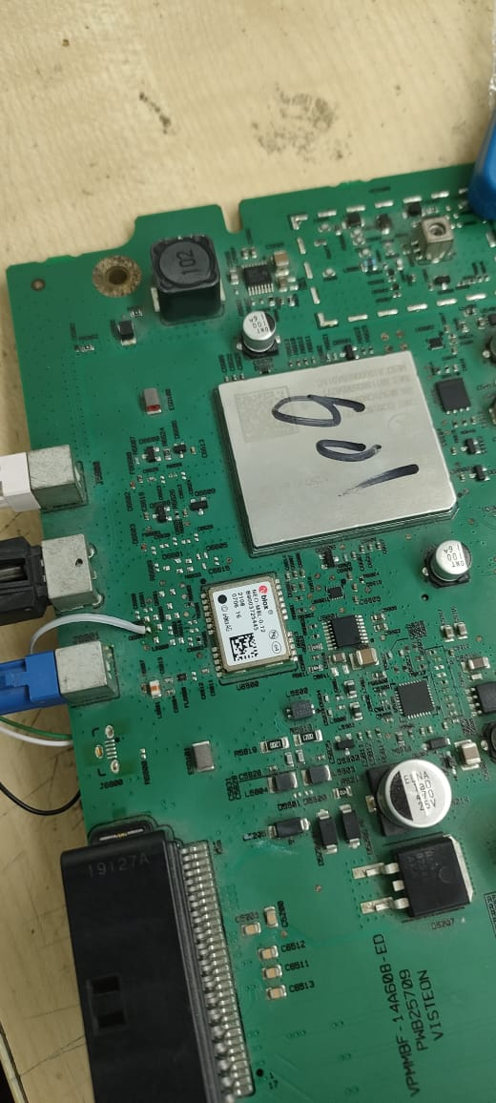
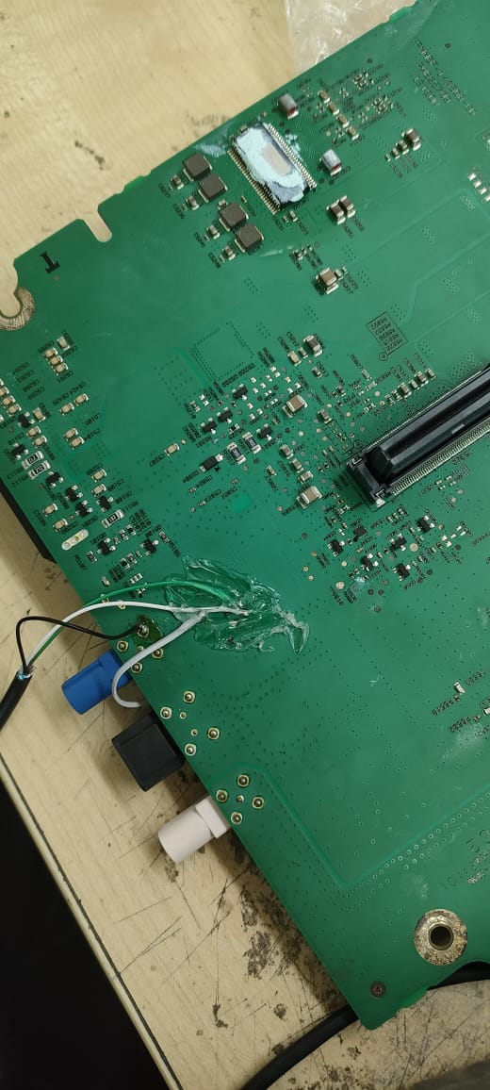
U-blox tapout

Slide 16
Gnss module is sending NMEA but not latching
-> Antenna connector issue
-> Antenna intended placement is changed
-> Gnss service issue
->with u-blox tap out need to check

Slide 17
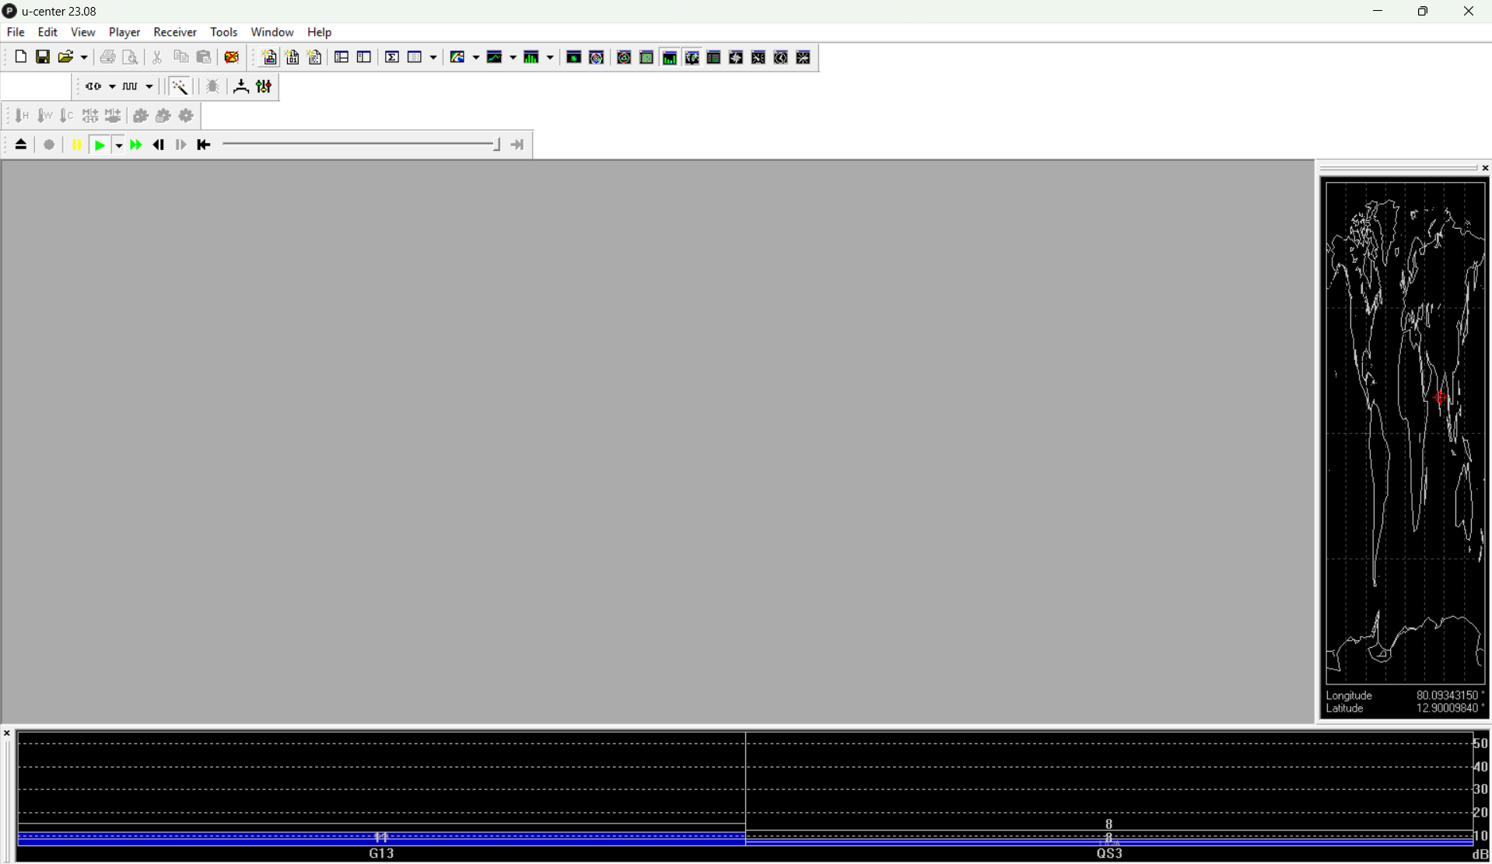
U-center application

Slide 18
THANK YOU

